Slide 1
Software Engineering
Lecture 5 – Quality Attributes

Slide 2


Slide 3
Interoperability
What is Interoperability?
Interoperability General Scenario
Tactics for Interoperability
A Design Checklist for Interoperability
Summary

Slide 4
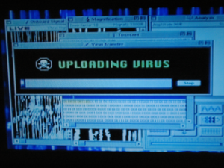
What is Interoperability?
Interoperability is about the degree to which two or more systems can usefully exchange meaningful information.
Scene from “Independence Day”
A mac is using apple-talk to communicate with an alien spaceship and upload a virus
Notes:
Like all quality attributes, interoperability is not a yes-or-no proposition but has shades of meaning.

Slide 5
Simpler words
Exchange information
Access services

Slide 6
Scenario
Bluetooth devices of old (and current)…
Big endian vs. Little endian
Protocol mismatch
Same function, different behaviour
Perhaps different from other quality attributes
Your solution depends on the solution of others

Slide 7
Scenario 2
Pipe and filter design pattern
find /etc -type f -exec cat '{}' \; |
tr -c '.[:digit:]' '\n' \ |
grep '^[^.][^.]*\.[^.][^.]*\.[^.][^.]*\.[^.][^.]*$'
Notes:
# Finds all IP addresses (xxx.xxx.xxx.xxx) in /etc directory files. # There a few extraneous hits. Can they be filtered out?

Slide 8
Internet of things
Different device manufacturers
Different protocols
Different sensors / formats
Metric vs. Imperial system

Slide 9
Exercise
Consider Interoperability for Google mail
What are some potential problems with interoperability?
Why are they problems?
What are the consequences of these problems?
Are standards sufficient to avoid problems?

Slide 10
Interoperability General Scenario
Portion of Scenario | Possible Values
Source | A system
Stimulus | A request to exchange information among system(s).
Environment | System(s) wishing to interoperate are discovered at run time or known prior to run time.
Response | One or more of the following: the request is (appropriately) rejected and appropriate entities (people or systems) are notified the request is (appropriately) accepted and information is exchanged successfully the request is logged by one or more of the involved systems
Response Measure | One or more of the following: percentage of information exchanges correctly processed percentage of information exchanges correctly rejected

Slide 11
Sample Concrete Interoperability Scenario
Our vehicle information system sends our current location to the traffic monitoring system. The traffic monitoring system combines our location with other information, overlays this information on a Google Map, and broadcasts it. Our location information is correctly included with a probability of 99.9%.

Slide 12
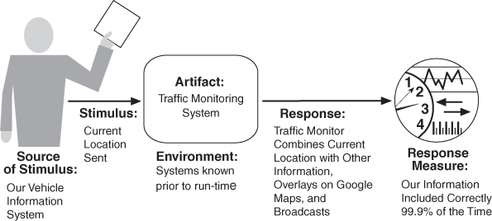
Concrete scenario

Slide 13
Goal of Interoperability Tactics
For two or more systems to usefully exchange information they must
Know about each other.
Exchange information in a semantically meaningful fashion.
Provide services in the correct sequence
Modify information produced by one actor to a form acceptable to the second actor.
Notes:
Know about each other - That is the purpose behind the locate tactics.
Exchange information in a semantically meaningful fashion. That is the purpose behind the manage interfaces tactics.

Slide 14
Goal of Interoperability Tactics

Slide 15
Interoperability Tactics

Slide 16
Locate
Discover service: Locate a service through searching a known directory service. There may be multiple levels of indirection in this location process – i.e. a known location points to another location that in turn can be searched for the service.

Slide 17
Manage Interfaces
Orchestrate: uses a control mechanism to coordinate, manage and sequence the invocation of services. Orchestration is used when systems must interact in a complex fashion to accomplish a complex task.
Tailor Interface: add or remove capabilities to an interface such as translation, buffering, or data-smoothing.
Notes:
Orchestration: workflow, process, procedure

Slide 18
Checklist
Allocation of responsibilities
Coordination model
Data model
Mapping among architectural elements
Management of resources
Binding time decisions
Choice of technology

Slide 19
Allocation of responsibilities
What parts of the system need to interoperate?
Functionality for
Accepting/Rejecting requests
Exchanging information
Notifying appropriate entities
Logging the request

Slide 20
Design Checklist for Interoperability
Allocation of Responsibilities | Determine which of your system responsibilities will need to interoperate with other systems. Ensure that responsibilities have been allocated to detect a request to interoperate with known or unknown external systems Ensure that responsibilities have been allocated to accept the request exchange information reject the request notify appropriate entities (people or systems) log the request (for interoperability in an untrusted environment, logging for non-repudiation is essential)

Slide 21
Coordination model
Coordinate between systems under your control and not under your control
Protocols, underlying networks, etc.
Consideration for other quality attributes
Concurrency, Timeliness, Jitter, etc.

Slide 22
Design Checklist for Interoperability
Coordination Model | Ensure that the coordination mechanisms can meet the critical quality attribute requirements. Considerations for performance include: Volume of traffic on the network both created by the systems under your control and generated by systems not under your control. Timeliness of the messages being sent by your systems Currency of the messages being sent by your systems Jitter of the messages arrival times. Ensure that all of the systems under your control make assumptions about protocols and underlying networks that are consistent with the systems not under your control.

Slide 23
Data model
Syntax and Semantics of interoperating systems
Translations, data formats, etc.
Encapsulation, etc.

Slide 24
Design Checklist for Interoperability
Data Model | Determine the syntax and semantics of the major data abstractions that may be exchanged among interoperating systems. Ensure that these major data abstractions are consistent with data from the interoperating systems. (If your system’s data model is confidential and must not be made public, you may have to apply transformations to and from the data abstractions of systems with which yours interoperates.)

Slide 25
Mapping among architectural elements
Can the component reach the network?
Security, Availability, Performance for communications

Slide 26
Design Checklist for Interoperability
Mapping Among Architectural Elements | For interoperability, the critical mapping is that of components to processors. Beyond the necessity of making sure that components that communicate externally are hosted on processors that can reach the network, the primary considerations deal with meeting the security, availability, and performance requirements for the communication. These will be dealt with in their respective chapters.

Slide 27
Resource management
Make sure interoperable systems can’t exhaust critical system resources
Policies for resource and shared systems use

Slide 28
Design Checklist for Interoperability
Resource Management | Ensure that interoperation with another system (accepting a request and/or rejecting a request) can never exhaust critical system resources (e.g., can a flood of such requests cause service to be denied to legitimate users?). Ensure that the resource load imposed by the communication requirements of interoperation is acceptable. Ensure that if interoperation requires that resources be shared among the participating systems, an adequate arbitration policy is in place.

Slide 29
Binding time
Which systems may interoperate?
When are they known to each other?
Policies for binding time?
Mechanisms for discovering services

Slide 30
Design Checklist for Interoperability
Binding Time | Determine the systems that may interoperate, and when they become known to each other. For each system over which you have control Ensure that it has a policy for dealing with binding to both known and unknown external systems. Ensure that it has mechanisms in place to reject unacceptable bindings and to log such requests. In the case of late binding, ensure that mechanisms will support the discovery of relevant new services or protocols, or the sending of information using chosen protocols.

Slide 31
Choice of technology
Choose technologies that are designed for interoperability (e.g. web services)
What parts are visible to interoperable services?
What consequences do those part have on other quality requirements?

Slide 32
Design Checklist for Interoperability
Choice of Technology | For any of your chosen technologies, are they “visible” at interface boundary of a system? If so, what interoperability effects do they have? Do they support, undercut, or have no effect on the interoperability scenarios that apply to your system? Ensure the effects they have are acceptable. Consider technologies that are designed to support interoperability, e.g. Web Services. Can they be used to satisfy the interoperability requirements for the systems under your control?

Slide 33
Summary
Interoperability refers to the ability of systems to usefully exchange information.
Achieving interoperability involves the relevant systems locating each other and then managing the interfaces so that they can exchange information.

Slide 34
Modifiability
Quality Attributes

Slide 35
Metrics
Cohesion
Coupling
Sufficiency
Completeness
Primitiveness

Slide 36
Modifiability
What is Modifiability?
Modifiability General Scenario
Tactics for Modifiability
A Design Checklist for Modifiability
Summary

Slide 37
What is Modifiability?
Modifiability is about change and our interest in it is in the cost and risk of making changes.

Slide 38
Difficulty of designing for modifiability
How to anticipate
How to control design and implementation
Knowing the patterns
Examples:
Marratech
Dem@Care
Memorylane
My former company
The HomeExams of this course

Slide 39
Exercise for modifiability
Consider modifiability for Google Mail
When/why should something be modifiable?
Who wants it to be modifiable?
How do we measure whether we made it modifiable?

Slide 40
Modifiability General Scenario
Portion of Scenario | Possible Values
Source | End user, developer, system administrator
Stimulus | A directive to add/delete/modify functionality, or change a quality attribute, capacity, or technology
Artifacts | Code, data, interfaces, components, resources, configurations, …
Environment | Runtime, compile time, build time, initiation time, design time
Response | One or more of the following: make modification test modification deploy modification
Response Measure | Cost in terms of: number, size, complexity of affected artifacts effort calendar time money (direct outlay or opportunity cost) extent to which this modification affects other functions or quality attributes new defects introduced

Slide 41
Planning for modifiability
To plan for modifiability, an architect has to consider three questions:
What can change?
What is the likelihood of the change?
When is the change made and who makes it?

Slide 42
Sample Concrete Modifiability Scenario
The developer wishes to change the user interface by modifying the code at design time. The modifications are made with no side effects within three hours.

Slide 43
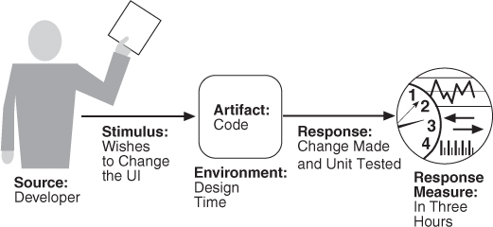
Concrete scenario

Slide 44
Goal of Modifiability Tactics
Tactics to control modifiability have as their goal controlling the complexity of making changes, as well as the time and cost to make changes.

Slide 45
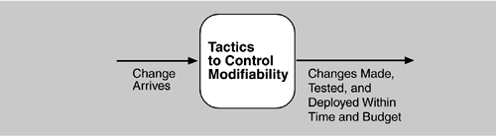
Goal of Modifiability Tactics

Slide 46
Modifiability Tactics

Slide 47
Reduce Size of a Module
Split Module: If the module being modified includes a great deal of capability, the modification costs will likely be high. Refining the module into several smaller modules should reduce the average cost of future changes.

Slide 48
Increase Cohesion
Increase Semantic Coherence: If the responsibilities A and B in a module do not serve the same purpose, they should be placed in different modules. This may involve creating a new module or it may involve moving a responsibility to an existing module.

Slide 49
Reduce Coupling
Encapsulate: Encapsulation introduces an explicit interface to a module. This interface includes an API and its associated responsibilities, such as “perform a syntactic transformation on an input parameter to an internal representation.”
Use an Intermediary: Given a dependency between responsibility A and responsibility B (for example, carrying out A first requires carrying out B), the dependency can be broken by using an intermediary.

Slide 50
Reduce Coupling
Restrict Dependencies: restricts the modules which a given module interacts with or depends on.
Refactor: undertaken when two modules are affected by the same change because they are (at least partial) duplicates of each other.
Abstract Common Services: where two modules provide not-quite-the-same but similar services, it may be cost-effective to implement the services just once in a more general (abstract) form.

Slide 51
Defer Binding
In general, the later in the life cycle we can bind values, the better.
If we design artifacts with built-in flexibility, then exercising that flexibility is usually cheaper than hand-coding a specific change.
However, putting the mechanisms in place to facilitate that late binding tends to be more expensive.

Slide 52
Checklist
Allocation of responsibilities
Coordination model
Data model
Mapping among architectural elements
Management of resources
Binding time decisions
Choice of technology

Slide 53
Allocation of responsibilities
What changes are likely to occur because of
Technical, Legal, Social, Business, Customer
What responsibilities need to be added / modded for change?
What other responsibilities are affected by change?

Slide 54
Design Checklist for Modifiability
Allocation of Responsibilities | Determine which changes or categories of changes are likely to occur through consideration of changes in technical, legal, social, business, and customer forces. For each potential change or category of changes Determine the responsibilities that would need to be added, modified, or deleted to make the change. Determine what other responsibilities are impacted by the change. Determine an allocation of responsibilities to modules that places, as much as possible, responsibilities that will be changed (or impacted by the change) together in the same module, and places responsibilities that will be changed at different times in separate modules.

Slide 55
Coordination model
What functionality / quality can change at runtime and how does it affect coordination?
What protocols / communication paths may change?
Reduce coupling (e.g. publish – subscribe)

Slide 56
Design Checklist for Modifiability
Coordination Model | Determine which functionality or quality attribute can change at runtime and how this affects coordination; for example, will the information being communicated change at run-time, or will the communication protocol change at run-time? If so, ensure that such changes affect a small number set of modules. Determine which devices, protocols, and communication paths used for coordination are likely to change. For those devices, protocols, and communication paths, ensure that the impact of changes will be limited to a small set of modules. For those elements for which modifiability is a concern, use a coordination model that reduces coupling such as publish/subscribe, defers bindings such as enterprise service bus, or restricts dependencies such as broadcast.

Slide 57
Data model
What data abstractions, operations, properties may change?
How does this affect other data abstractions?
Pick data abstractions that minimize severity of change / modification
Make sure that components using the data are changed together

Slide 58
Design Checklist for Modifiability
Data Model | Determine which changes (or categories of changes) to the data abstractions, their operations, or their properties are likely to occur. Also determine which changes or categories of changes to these data abstractions will involve their creation, initialization, persistence, manipulation, translation, or destruction. For each change or category of change, determine if the changes will be made by an end user, system administrator, or developer. For those changes made by an end user or administrator, ensure that the necessary attributes are visible to that user and that the user has the correct privileges to modify the data, its operations, or its properties. For each potential change or category of change determine which data abstractions need to be added, modified, or deleted determine whether there would be any changes to the creation, initialization, persistence, manipulation, translation, or destruction of these data abstractions determine which other data abstractions are impacted by the change. For these additional abstractions, determine whether the impact would be on their operations, properties, creation, initialization, persistence, manipulation, translation, or destruction. ensure an allocation of data abstractions that minimizes the number and severity of modifications to the abstractions by the potential changes Design your data model so that items allocated to each element of the data model are likely to change together.

Slide 59
Mapping among architectural elements
Use deferred binding of mapping decisions

Slide 60
Design Checklist for Modifiability
Mapping Among Architectural Elements | Determine if it is desirable to change the way in which functionality is mapped to computational elements (e.g. processes, threads, processors) at runtime, compile time, design time, or build time. Determine the extent of modifications necessary to accommodate the addition, deletion, or modification of a function or a quality attribute. This might involve a determination of, for example: execution dependencies assignment of data to databases assignment of runtime elements to processes, threads, or processors Ensure that such changes are performed with mechanisms that utilize deferred binding of mapping decisions.

Slide 61
Resource management
What changes result in adding/removing resources
How will resource limits change?
Do they still enough for system requirements?

Slide 62
Design Checklist for Modifiability
Resource Management | Determine how the addition, deletion, or modification of a responsibility or quality attribute will affect resource usage. This involves, for example, determining what changes might introduce new resources or remove old ones or affect existing resource usage. determining what resource limits will change and how Ensure that the resources after the modification are sufficient to meet the system requirements. Encapsulate all resource managers and ensure that the policies implemented by those resource managers utilize are themselves encapsulated and bindings are deferred to the extent possible.

Slide 63
Binding time
Use defer-binding for changes at runtime
But don’t overdo it (complex or unknown dependencies)
What is the cost of the deferred binding?

Slide 64
Design Checklist for Modifiability
Binding Time | For each change or category of change Determine the latest time at which the change will need to be made. Choose a defer-binding mechanism (see Section 7.2.4) that delivers the appropriate capability at the time chosen. Determine the cost of introducing the mechanism and the cost of making changes using the chosen mechanism Do not introduce so many binding choices that change is impeded because the dependencies among the choices are complex and unknown.

Slide 65
Choice of technology
Consider how easy/hard it is to make changes with current technology choices
Source-code access?
Hardware support?

Slide 66
Design Checklist for Modifiability
Choice of Technology | Determine what modifications are made easier or harder by your technology choices. Will your technology choices help to make, test, and deploy modifications? How easy is it to modify your choice of technologies itself (in case some of these technologies change or become obsolete)? Choose your technologies to support the most likely modifications. For example, an Enterprise Service Bus makes it easier to change how elements are connected but may introduce vendor lock in.

Slide 67
Summary
Modifiability deals with change and the cost in time or money of making a change, including the extent to which this modification affects other functions or quality attributes.
Tactics to reduce the cost of making a change include making modules smaller, increasing cohesion, and reducing coupling. Deferring binding will also reduce the cost of making a change.

Slide 68
Performance
Quality attribute

Slide 69
Performance
What is Performance?
Performance General Scenario
Tactics for Performance
A Design Checklist for Performance
Summary

Slide 70
What is Performance?
Performance is about time
meet timing requirements.
Must respond to stimuli in time
Interrupts
Messages
Requests from users and systems
Clock events

Slide 71
Scenario
A healthcare device requires real-time health analysis from a wrist-watch
What are the constraints / limitations?
Battery capacity on the wrist-watch
Computational capacity on the wrist-watch
Raw-data density and capacity to handle it
Consider splitting calculations between devices/cloud
Improve efficiency of algorithms.

Slide 72
Exercise
Consider performance for Google mail
When is performance especially important?
How do we measure performance?
How do we control resource demands?
How do we manage resources?

Slide 73
Performance General Scenario
Portion of Scenario | Possible Values
Source | Internal or external to the system
Stimulus | Arrival of a periodic, sporadic, or stochastic event
Environment | Operational mode: normal, emergency, peak load, overload.
Response | Process events, change level of service
Response Measure | Latency, deadline, throughput, jitter, miss rate

Slide 74
Sample Concrete Performance Scenario
Users initiate transactions under normal operations. The system processes the transactions with an average latency of two seconds.

Slide 75
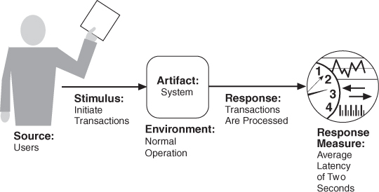
Concrete scenario

Slide 76
Goal of Performance Tactics
Tactics to control Performance have as their goal to generate a response to an event arriving at the system within some time-based constraint.

Slide 77
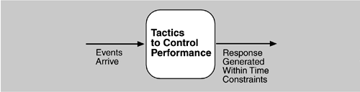
Goal of Performance Tactics

Slide 78
Question
How do we design for performance?

Slide 79
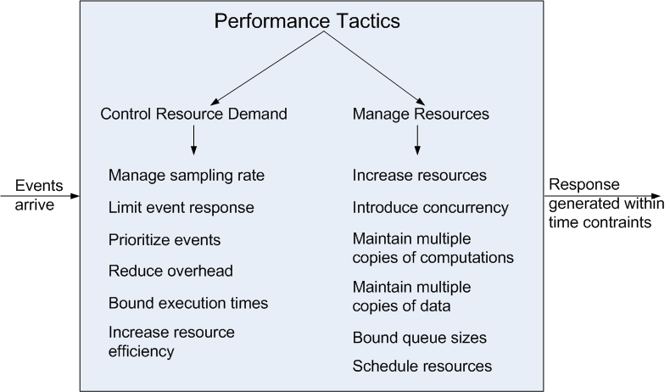
Performance Tactics

Slide 80
Control Resource Demand
Manage Sampling Rate: If it is possible to reduce the sampling frequency at which a stream of data is captured, then demand can be reduced, typically with some loss of fidelity.
Limit Event Response: process events only up to a set maximum rate, thereby ensuring more predictable processing when the events are actually processed.
Prioritize Events: If not all events are equally important, you can impose a priority scheme that ranks events according to how important it is to service them.

Slide 81
Control Resource Demand
Reduce Overhead: The use of intermediaries (important for modifiability) increases the resources consumed in processing an event stream; removing them improves latency.
Bound Execution Times: Place a limit on how much execution time is used to respond to an event.
Increase Resource Efficiency: Improving the algorithms used in critical areas will decrease latency.

Slide 82
Manage Resources
Increase Resources: Faster processors, additional processors, additional memory, and faster networks all have the potential for reducing latency.
Increase Concurrency: If requests can be processed in parallel, the blocked time can be reduced. Concurrency can be introduced by processing different streams of events on different threads or by creating additional threads to process different sets of activities.
Maintain Multiple Copies of Computations: The purpose of replicas is to reduce the contention that would occur if all computations took place on a single server.

Slide 83
Manage Resources
Maintain Multiple Copies of Data: keeping copies of data (possibly one a subset of the other) on storage with different access speeds.
Bound Queue Sizes: control the maximum number of queued arrivals and consequently the resources used to process the arrivals.
Schedule Resources: When there is contention for a resource, the resource must be scheduled.

Slide 84
Checklist
Allocation of responsibilities
Coordination model
Data model
Mapping among architectural elements
Management of resources
Binding time decisions
Choice of technology

Slide 85
Allocation of responsibilities
Determine the system’s responsibilities with
heavy loading requirements
have time-critical response requirements
heavily used
impact portions of the system where heavy loads or time critical events occur.
Processing requirements, shared resources, performance related artifacts

Slide 86
Design Checklist for Performance
Allocation of Responsi-bilities | Determine the system’s responsibilities that will involve heavy loading, have time-critical response requirements, are heavily used, or impact portions of the system where heavy loads or time critical events occur. For those responsibilities, identify processing requirements of each responsibility and determine whether they may cause bottlenecks additional responsibilities to recognize and process requests appropriately including responsibilities that result from a thread of control crossing process or processor boundaries. responsibilities to manage the threads of control —allocation and de-allocation of threads, maintaining thread pools, and so forth. responsibilities for scheduling shared resources or managing performance-related artifacts such as queues, buffers, and caches. For the responsibilities and resources you identified, ensure that the required performance response can be met (perhaps by building a performance model to help in the evaluation).

Slide 87
Coordination model
Model that supports concurrency
Supports periodic, stochastic, or sporadic event arrivals
guaranteed delivery, throughput, latency

Slide 88
Design Checklist for Performance
Coordination Model | Determine the elements of the system that must coordinate with each other—directly or indirectly—and choose communication and coordination mechanisms that supports any introduced concurrency (for example, is it thread-safe?), event prioritization, or scheduling strategy ensures that the required response times can be met can capture periodic, stochastic, or sporadic event arrivals, as needed have the appropriate properties of the communication mechanisms, for example, stateful, stateless, synchronous, asynchronous, guaranteed delivery, throughput, or latency.

Slide 89
Data model
Determine critical data
Heavy load / time-critical
Consider
Using multiple copies of key data
Partitioning data
Reducing processing requirements
Adding resources to deal with bottlenecks

Slide 90
Design Checklist for Performance
Data Model | Determine those portions of the data model that will be heavily loaded, have time critical response requirements, are heavily used, or impact portions of the system where heavy loads or time critical events occur. For those data abstractions, determine whether maintaining multiple copies of key data would benefit performance partitioning data would benefit performance whether reducing the processing requirements for the creation, initialization, persistence, manipulation, translation, or destruction of the enumerated data abstractions is possible whether adding resources to reduce bottlenecks for the creation, initialization, persistence, manipulation, translation, or destruction of the enumerated data abstractions is feasible.

Slide 91
Mapping among architectural elements
Co-locating critical resources
Reduce loading, improve efficiency
Assign heavy computational components to the processor with most capacity

Slide 92
Design Checklist for Performance
Mapping Among Architectural Elements | Where heavy network loading will occur, determine whether co-locating some components will reduce loading and improve overall efficiency. Ensure that components with heavy computation requirements are assigned to processors with the most processing capacity. Determine where introducing concurrency (that is, allocating a piece of functionality to two or more copies of a component running simultaneously) is feasible and has a significant positive effect on performance. Determine whether the choice of threads of control and their associated responsibilities introduces bottlenecks.

Slide 93
Resource management
Determine critical and limited resources for performance
Monitor and manage quality of service

Slide 94
Design Checklist for Performance
Resource Management | Determine which resources in your system are critical for performance. For these resources ensure they will be monitored and managed under normal and overloaded system operation. For example system elements that need to be aware of, and manage, time and other performance-critical resources process/thread models prioritization of resources and access to resources scheduling and locking strategies deploying additional resources on demand to meet increased loads

Slide 95
Binding time
Consider
Required time to complete binding
Additional overhead

Slide 96
Design Checklist for Performance
Binding Time | For each element that will be bound after compile time, determine the time necessary to complete the binding additional overhead introduced by using the late binding mechanism Ensure that these values do not pose unacceptable performance penalties on the system.

Slide 97
Choice of technology
How does your choice of technology affect performance?
Does it meet requirements?
Does it add unacceptable overhead?
Can you control resource limitations?
Example: web-frameworks like Zend, etc.

Slide 98
Design Checklist for Performance
Choice of Technology | Will your choice of technology let you set and meet hard real time deadlines? Do you know its characteristics under load and its limits? Does your choice of technology give you the ability to set scheduling policy priorities policies for reducing demand allocation of portions of the technology to processors other performance related parameters Does your choice of technology introduce excessive overhead for heavily used operations?

Slide 99
Summary
Performance is about the management of system resources in the face of particular types of demand to achieve acceptable timing behavior.
Performance can be measured in terms of throughput and latency for both interactive and embedded real time systems.
Performance can be improved by reducing demand or by managing resources more appropriately.

